Slide 1
MARS Rover

Slide 2
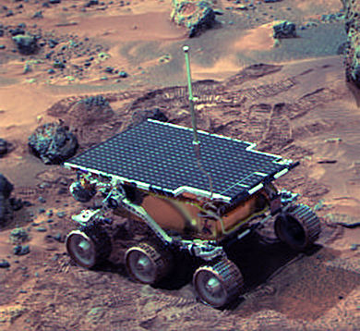
Introduction
It started on July 1994, when the Sojourner Rover landed on Mars to explore the planet. Since then, multiple other successors had landed on Mars to carry out the same objectives, more precisely and accurately.
The Mars 2020 Perseverance Rover is based on the Mars Science Laboratory’s latest Curiosity rover configuration. It is car-sized, about 10 feet long (not including the arm), 9 feet wide, and 7 feet tall (about 3 meters long, 2.7 meters wide, and 2.2 meters tall). But at 2,260 pounds (1,025 kilograms), it weighs less than a compact car. In some sense, the rover parts are similar to what any living creature would need to keep it "alive" and able to explore the planet Mars.

Slide 3
Overview
#1 Physical Design for various applications
#2 Propulsion System and Actuators
#3 Navigation System and Control
#4 Data Transmission
#5 Data Collection
#6 Power Management System

Slide 4
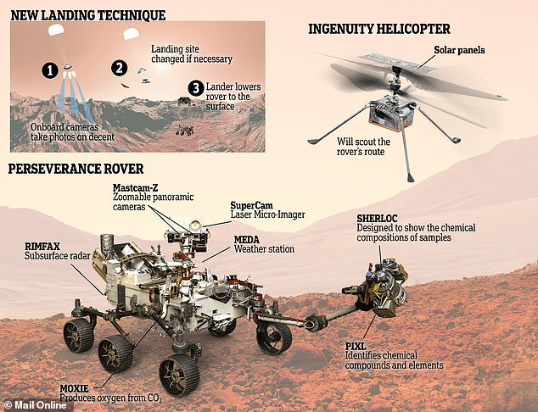
General Components

Slide 5
Physical Design for various applications
MARS Perseverance Rover is equipped with the MARS Helicopter (Ingenuity) to check its route to ensure its safety.
The 100kg-Rover body is a strong outer layer designed to protect the computer and electronic components.
The Rover has a weather station to keep its body temperature at around 7 degrees Celsius even when the surrounding is freezing. This protects key components such as the battery and some of the sensitive electronics from harm at very cold temperatures.
The Rover also has a Moxie box which traps Carbon Dioxide to convert it into Oxygen as fuel propellent and to test for future manned missions.
It consists of six tires as it applies the rocker-bogie mechanism to move on the harsh surface of Mars. They are made of aluminum, with cleats for traction and curved titanium spokes as the rim for springy support. The threads of the cleats are tighter, higher and smoother compared to Curiosity. This gets rid of the hot spots that caused damage to the Curiosity tires.

Slide 6
Propulsion System and Actuators
The Rover moves autonomously, with separately controlled motors for each wheel that utilizes rocker-bogie mechanism.
The rover's rocker-bogie suspension enables the rover to drive over obstacles (such as rocks) or through depressions that are as large as the rover's wheel (52.5-centimeters, 20.7-inches).
The two front and two rear wheels also have individual steering motors. This steering capability allows the vehicle to turn in place, a full 360 degrees. The four-wheel steering also allows the rover to swerve and curve, making arcing turns.
There are two robotic arms, one at the front, the other at the bottom of the rover. The bottom arm is used to keep the sample in a sealed tube. The sealed tube is placed back on Martian land.
The front robotic arm extract cores from rocks, takes microscopic images and analyzes the elemental composition and mineral makeup of Martian rocks and soil. It has 5 DOF.
The rover can move autonomously and manually by the engineers on Earth.

Slide 7
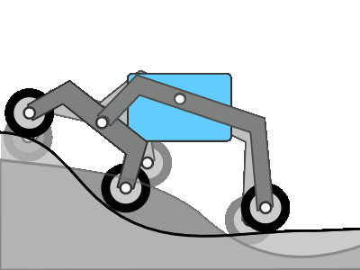
Rocker-bogie Mechanism
Based on the diagram below, the rocker part of the suspension comes from the rocking aspect of the larger, body-mounted linkage on each side of the rover.
The bogie part refers to the smaller linkage that pivots to the rocker in the middle and which has a drive wheel at each end.
The rockers are attached either side of the rover with the body through a differential. One end of the rocker is attached to a wheel and the other is pivoted to the bogie.
Based on the low center of mass, the Perseverance rover can withstand a tilt of at least 45 degrees in any direction without overturning.
The differential link allows the rover go through different obstacles on either side at the same time in a stable way.

Slide 8
Navigation System and Control
The Rover can move autonomously and monitor its health.
The rover has an Inertial Measurement Unit (IMU) that provides 3-axis information on its position, which enables the rover to make precise vertical, horizontal, and side-to-side (yaw) movements. The device is used in rover navigation to support safe traverses and to estimate the degree of tilt the rover is experiencing on the surface of Mars. The rover avoids surface that tilts 30 degrees and above.
Two color stereo Navigation Cameras, called Navcams, help navigate Perseverance safely when the rover operates autonomously, making its own navigation decisions without consulting controllers on Earth.
The optical sensor feeds data into its machine learning vision algorithm.

Slide 9
Navigation System and Control
The Rover can move autonomously and monitor its health.
When it is controlled by the engineers, the Navcams help ensuring a safe path as it can detect a golf ball 82 feet away. The engineers can command rover to go certain distance in certain direction.
HazCams detect hazards to the front and back pathways of the rover, such as large rocks, trenches, or sand dunes. As the rover is driving, it literally builds the map of the route it drives on Mars.

Slide 10
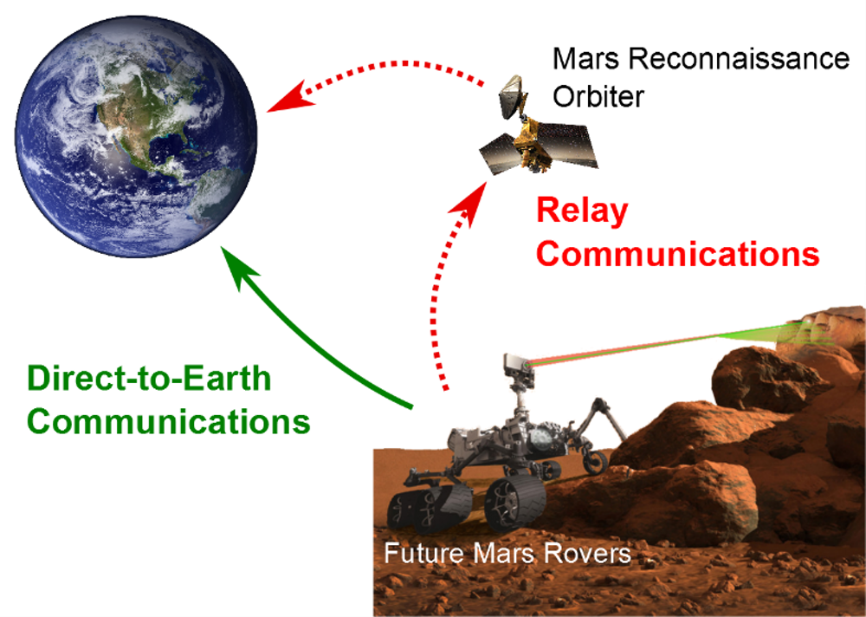
Data Transmission
The Rover has three antennas which are Ultra-High Frequency, High-Gain and Low-Gain Antenna. They are the “voice” and “ears” of the Rover.
UHF communicates with the Earth through NASA’s Mars orbiters using high frequency waves around 400MHz. The orbiters then use their much larger antennas and transmitters to relay that data on the long-distance link back to Earth.
The high-gain antenna is steerable so it can point its radio beam in a specific direction. It transmits data directly to and from Earth.
Activities such as taking pictures, driving, and operating the instruments are performed under commands transmitted in a command sequence to the rover from the flight team back on Earth.

Slide 11
Data Collection
The Rover has microphones, antennas, cameras.
SuperCam microphone gives the rover the chance to hear the sounds of Mars while performing science observations. The EDL microphone records the sound during landing on the surface.
The Low-Gain Antenna is used for receiving data from the Earth.
CacheCam takes microscopic pictures of the sample before sealed in a tube. MastCam-Z is 3D view camera that can see similar to what human eyes can see. SuperCam fires lasers at targets beyond reach. The laser examines if there is past life based on chemistry.
PIXL uses X-ray fluorescence to identify chemical elements and has micro camera to verify visible characteristics.
SHERLOC uses spectrometers, lasers and extreme close-up cameras for studying a certain area.
WATSON camera captures images that bridge SHERLOC, Mastcam-Z and SuperCam outputs. It can also monitor the functionality of other parts such as the Moxie.

Slide 12
Data Collection
The Rover has microphones, antennas, cameras.
The Radar Imager (RIMFAX) uses radar waves to probe the ground under the rover. It is used to see geologic features under the surface with ground-penetrating radar.

Slide 13
Power Management System
Generates its own electricity and maintaining its power.
Uses radio isotope(Plutonium Dioxide) thermal-electric generator which converts heat from natural decaying of radio isotopes into electricity.
Seebeck effect: direct conversion of temperature differences to electrical voltage via a thermocouple. It requires two semiconductors which carries electrons(Lead Telluride) and holes(Tellurium, Antimony, Germanium, Silver).
When heat is applied, the electron will move to fill in the holes, producing electricity.
4.8kg Plutonium Dioxide is placed as the steady heat supply.
This process can generate 110 Watts of power at one time and can operate for 14 years.
Two lithium-ion rechargeable batteries to meet demands of rover activities that temporarily exceeds the generator’s steady electrical output levels such as when using Moxie.

Slide 14
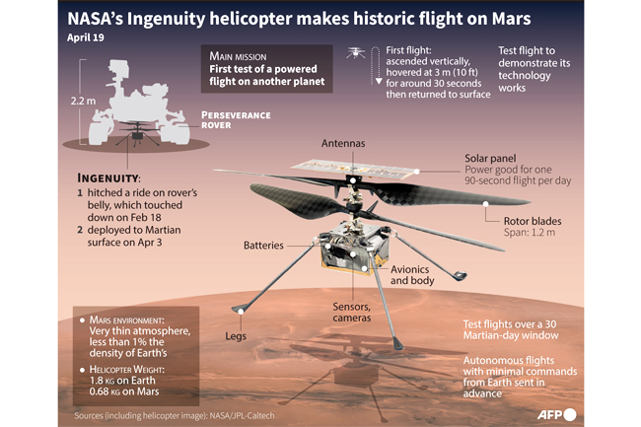
MARS Helicopter

Slide 15
MARS Helicopter
The MARS Helicopter called Ingenuity’s main function is to check the route for the Perseverance Rover to take. This is important to ensure the safety of the rover on the Martian land.
Flying Mechanism on planet Mars is different because it has less air to push down. It requires two blades that are counter-rotating in a much faster velocity than for normal helicopters. The material is high strength carbon composites. The rotation rate is 2400rpm.
Power System uses solar panel to charge 6 lithium ion batteries on board that powers the motors and navigation cameras. The battery capacity is between 35-40Wh. Most energy is used to keep the helicopter body warm. Only one-third is used to fly the robot.
Navigation System and Control. It has multiple sensors which are inclinator, gyro, accelerometer, altimeter and camera. Real-time estimation is made continuously and fed into a closed loop algorithm, which corrects the error at the blades. It also has navigation sensors to detect the terrains.

Slide 16
MARS Helicopter
Physical Design where the helicopter is very lightweight at 1.8kg only in total. This is important to ensure the helicopter can be lifted properly. Even the solar panel is designed lighter than usual. The base is very large to ensure safe and balanced landing.
Fuselage shell in the center of the helicopter to give heat to the helicopter by trapping carbon dioxide is used as insulation material as there is space between battery and circuit boards. CO2 is used because it is light and suffice the thermal model it needs.
Camera. It has two cameras. One is colored and the other is black-and-white. The camera can see very far and in high definition pictures.

Slide 17
Hardware
ITEMS | LINK
Lithium Ion Battery | https://www.ebay.com/b/Li-Ion-Rechargeable-Batteries-800-mAh-Amp-Hours/48619/bn_7116958002
6-DOF Accelerometer and Gyro | https://my.cytron.io/p-gy-521-mpu6050-6dof-accelerometer-plus-gyro?r=1&gclid=Cj0KCQjw9_mDBhCGARIsAN3PaFPePvjWeAyT2nYy1roEV6A6HwG3RwcUC_y1RhjxWlr2-fx-t2oQIZ8aAkcqEALw_wcB
Inclinometer | https://my.rs-online.com/web/p/spirit-levels-inclinometers/2006118
Brushless DC Motor | https://sea.banggood.com/BrotherHobby-Avenger-2806
Altimeter Sensor | https://my.cytron.io/p-mpl3115a2-i2c-barometric-altitude-temperature-sensor?r=1&gclid=Cj0KCQjw9_mDBhCGARIsAN3PaFNfGXVgRNtmFSKbkE-wqjzRbGQLUy7XTp-iAviHtA9DSeIoBHN9NWAaAvkGEALw_wcB

Slide 18
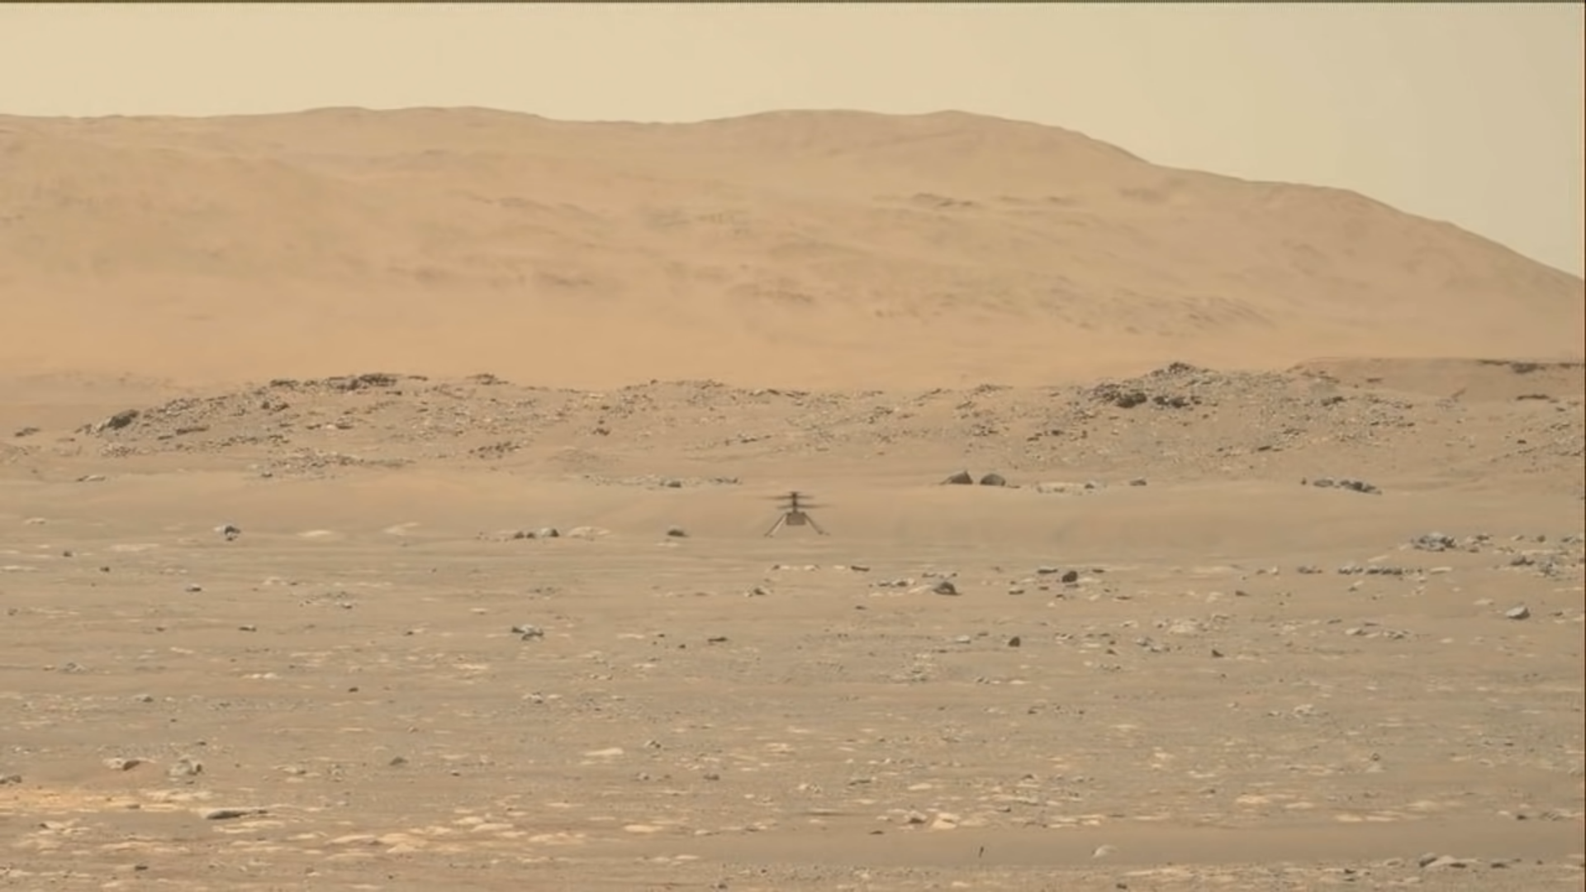
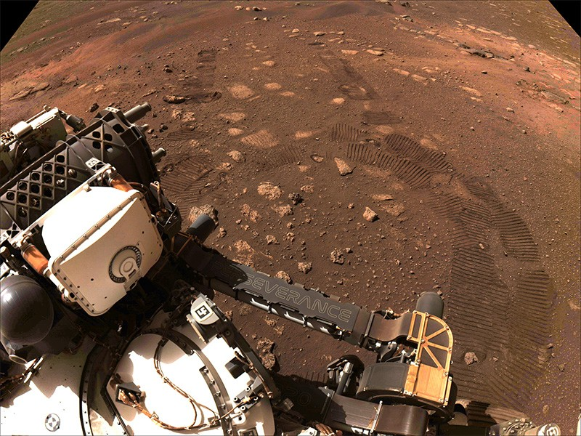
Perseverance Rover LATEST!
Mars Helicopter successful takeoff and landing on Mars just informed yesterday by Nasa JPL(left). The Perseverance is currently exploring Mars(right)!

Slide 19
THANK YOU!

